Slide 1

Team Members:
Burke, John
Gonzalez, Emmanuel
Medina,Jorge
Munez,Nilton
Senior Project Final Presentation Fall 2016
BOLO 5.0
Product Owners:
Ceballos, Samuel
Cohen, Jason
25 July 2016
1
Notes:
Greet your audience, thank them for attending your presentation, introduce yourself, introduce your project, introduce your team members, and quickly indicate what each of you did in a high-level manner, and put more emphasis on your part/contribution.

Slide 2
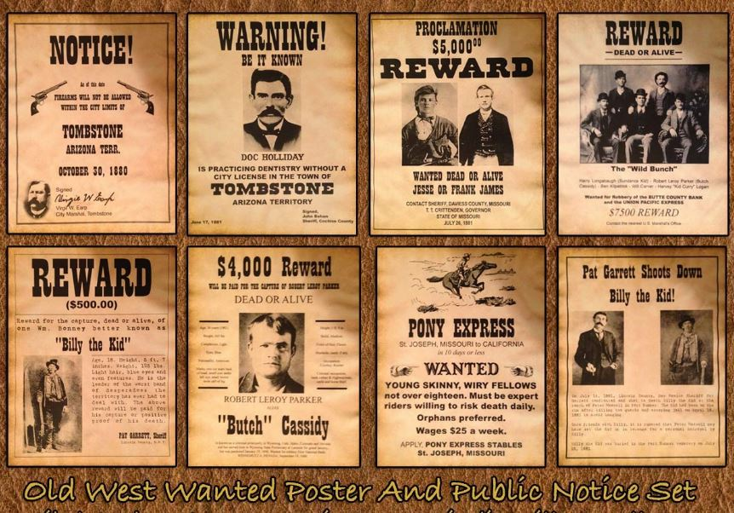
Project definition (20 seconds)
Whole Project (all versions):
The story of your project in all versions (from beginning)
screenshots or GIF pictures of the whole project
2
Notes:
Introduce the problem that the whole project tackles and stay focused on the parts that you have been working. Indicate if there is an existing previous system, enumerate its problems/limitations, etc.

Slide 3
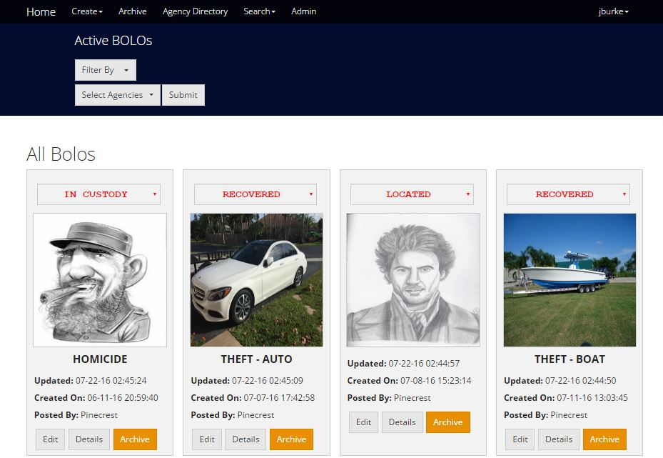
Project definition (15 seconds)
Whole Project:
The story of your project in the new version(This semester)
screenshots or GIF pictures of the whole project
3
Notes:
Introduce the problem that the whole project tackles and stay focused on the parts that you have been working. Indicate if there is an existing previous system, enumerate its problems/limitations, etc.

Slide 4
Requirements: Use Cases
Notes:
5 seconds
Show the Use Case Diagram for the whole project. Highlight your use cases.

Slide 5

System Design: Architecture
Notes:
20 seconds
System design: Highlight the parts that you contributed to them.
1. System decomposition; identify the architecture patterns used
2. System deployment – h/w and s/w requirements

Slide 6

Minimal Class Diagram
Notes:
10 seconds.
Minimal class diagram. Highlight the classes that you created/modified
Identify the design patterns used (one or more slides).

Slide 7

User Stories
1. US # 1098 Implement an About FIU’s Contribution page
2. User Story # 1006 Add a user guide page for each tier
2. US # 1096 Implement a link to download a PDF of the user's guide based on user's tier
3. US # 1010 Create a front end page for root to customize system settings
4. US # 1097 Implement an About Miami Dade County Association of Chief of Police (MDCACP) page
4
Notes:
4. Requirements:
4.1. User stories implemented (one or more slides).
4.2. UML use cases and the use case diagram for the implemented use cases (one or more slides).
4.3. UML sequence diagrams for the implemented use cases.

Slide 8
User Stories
6. US# 1100 Create a front end page where root can retrieve data for analysis
7. User Story # 1099 Create an about us page for IBM's contribution
8. User Story # 935 Add drop down for links such as settings, user guide, logout and others to be added at a later time
9. User Story # 934 Remove unnecessary fields from PDF BOLO display
10. User Story # 1046 Add an About Us page
5
Notes:
4. Requirements:
4.1. User stories implemented (one or more slides).
4.2. UML use cases and the use case diagram for the implemented use cases (one or more slides).
4.3. UML sequence diagrams for the implemented use cases.

Slide 9
User Stories
11. User Story # 930 Send email notification after my password has been reset
12. User Story # 919 Adjust the timeout secession to ten minutes
13. User Story # 893 Authenticate password reset confirmation
14. User Story #887 Remove unnecessary details from email alert
6
Notes:
4. Requirements:
4.1. User stories implemented (one or more slides).
4.2. UML use cases and the use case diagram for the implemented use cases (one or more slides).
4.3. UML sequence diagrams for the implemented use cases.

Slide 10

User Story #1: the tile of user story
The most important user story you worked on it
Go into the details of the most important/significant tasks using bullets or visual graphs or diagrams
Demo using screenshots or GIF
7
Notes:
4. Requirements:
4.1. User stories implemented (one or more slides).
4.2. UML use cases and the use case diagram for the implemented use cases (one or more slides).
4.3. UML sequence diagrams for the implemented use cases.

Slide 11


8
Notes:
4. Requirements:
4.1. User stories implemented (one or more slides).
4.2. UML use cases and the use case diagram for the implemented use cases (one or more slides).
4.3. UML sequence diagrams for the implemented use cases.

Slide 12
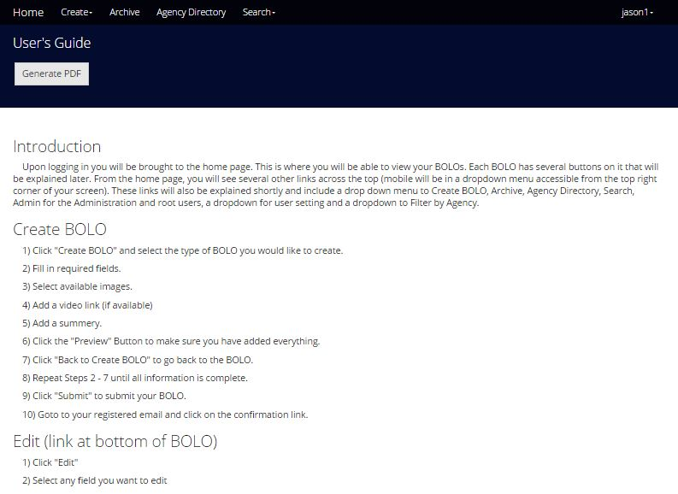
9
Notes:
4. Requirements:
4.1. User stories implemented (one or more slides).
4.2. UML use cases and the use case diagram for the implemented use cases (one or more slides).
4.3. UML sequence diagrams for the implemented use cases.

Slide 13
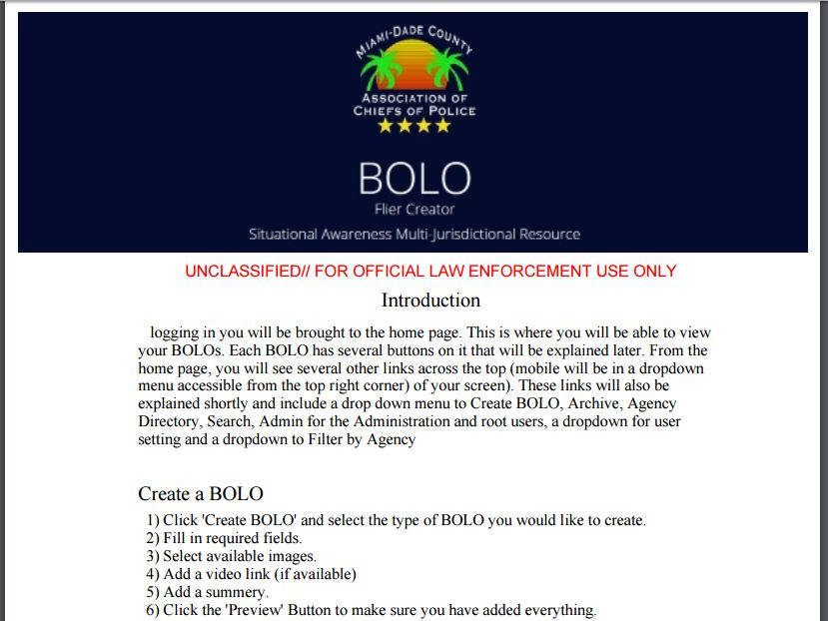
User Story #3: the tile of user story
Go into the details of the most important/significant tasks using bullets or visual graphs or diagrams
Demo using screenshots or GIF
10
Notes:
4. Requirements:
4.1. User stories implemented (one or more slides).
4.2. UML use cases and the use case diagram for the implemented use cases (one or more slides).
4.3. UML sequence diagrams for the implemented use cases.

Slide 14
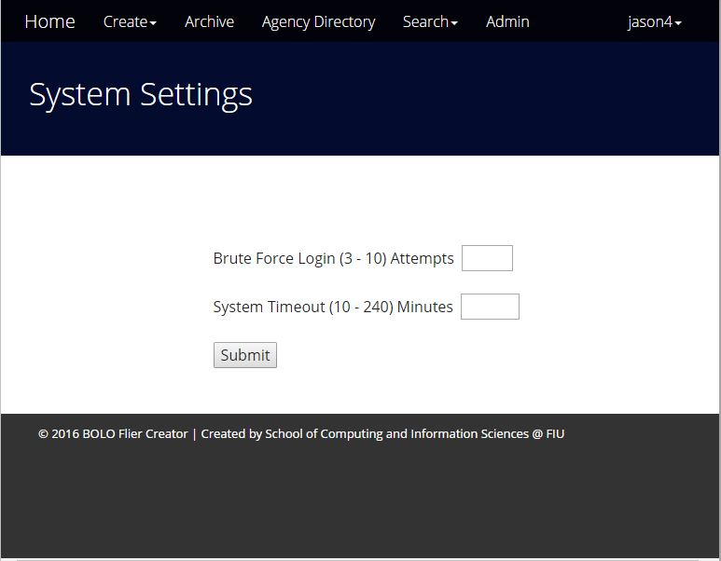
User Story #4: the tile of user story
Go into the details of the most important/significant tasks using bullets or visual graphs or diagrams
Demo using screenshots or GIF
Notes:
4. Requirements:
4.1. User stories implemented (one or more slides).
4.2. UML use cases and the use case diagram for the implemented use cases (one or more slides).
4.3. UML sequence diagrams for the implemented use cases.

Slide 15
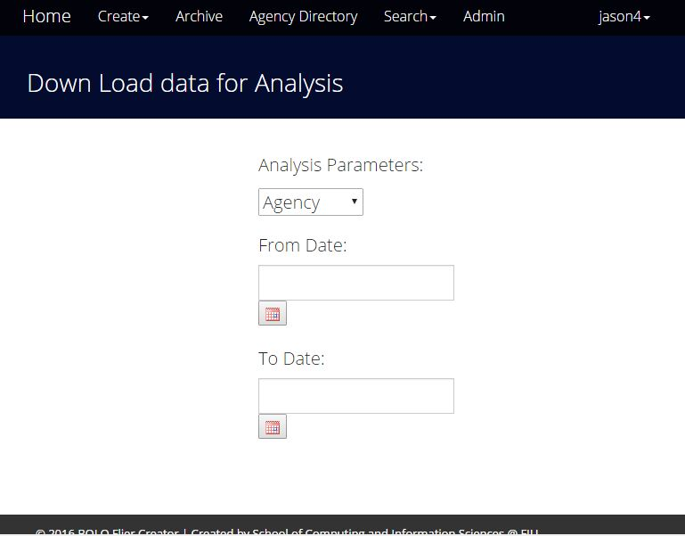
User Story #5: the tile of user story
Go into the details of the most important/significant tasks using bullets or visual graphs or diagrams
Demo using screenshots or GIF
Notes:
4. Requirements:
4.1. User stories implemented (one or more slides).
4.2. UML use cases and the use case diagram for the implemented use cases (one or more slides).
4.3. UML sequence diagrams for the implemented use cases.

Slide 16
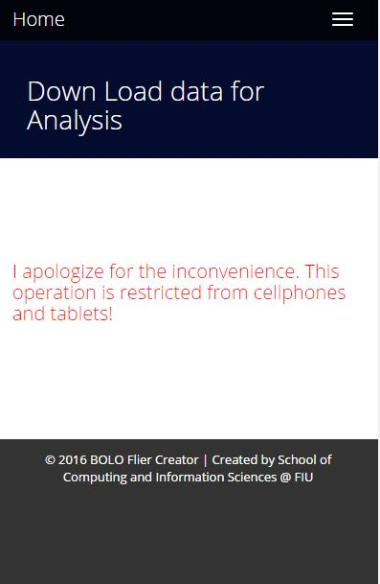
Notes:
4. Requirements:
4.1. User stories implemented (one or more slides).
4.2. UML use cases and the use case diagram for the implemented use cases (one or more slides).
4.3. UML sequence diagrams for the implemented use cases.

Slide 17
Test Suites and Test Cases
Notes:
10 seconds
A description of verification process and Test Suites and Test Cases for one of the use cases.
1 One sunny day and one rainy day for the implemented use cases (one or more slides).
2 Automated test scripts for the implemented use cases (if any) (one or more slides).

Slide 18
John Burke
jburk045@fiu.edu
Home: (305)256-2982
Cell: none
Notes:
Summarize your contribution
Include your contact information
Ask if anyone has any questions for you.
Thank your audience

Slide 19








Questions?
Thank You for your time!
Notes:
Summarize your contribution
Include your contact information
Ask if anyone has any questions for you.
Thank your audience

